Slide 1

Python as an Additional Language
Lesson 8: What Kind Of Day Has It Been?

Slide 2
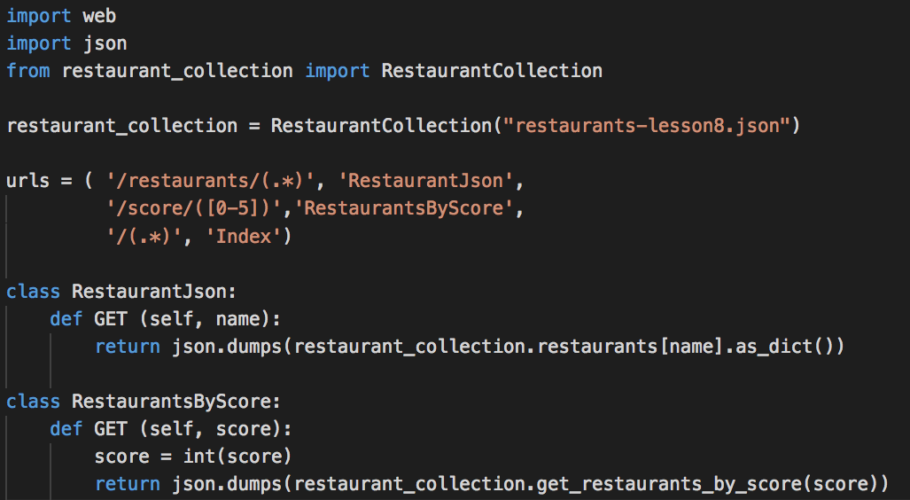

Where did we get to?

Slide 3
The Roads less travelled
What we haven’t covered:
XML
SQL and NoSQL Databases
Raw TCP sockets
Other things… ?
What might our code look like if we were to use these storage methods / technologies?
Files for today: http://go/e-mv99ww

Slide 4
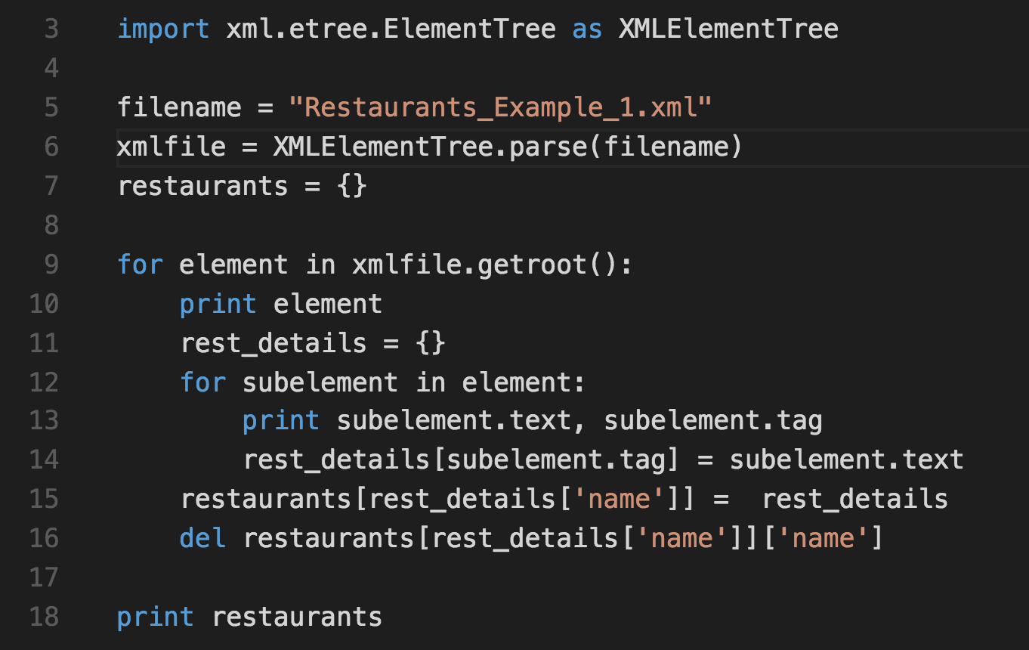
XML
Notes:
This is xml_reader.py from the examples directory. Take a look at what happens if we try to read the other xml files. We might need the subelement.attrib property

Slide 5
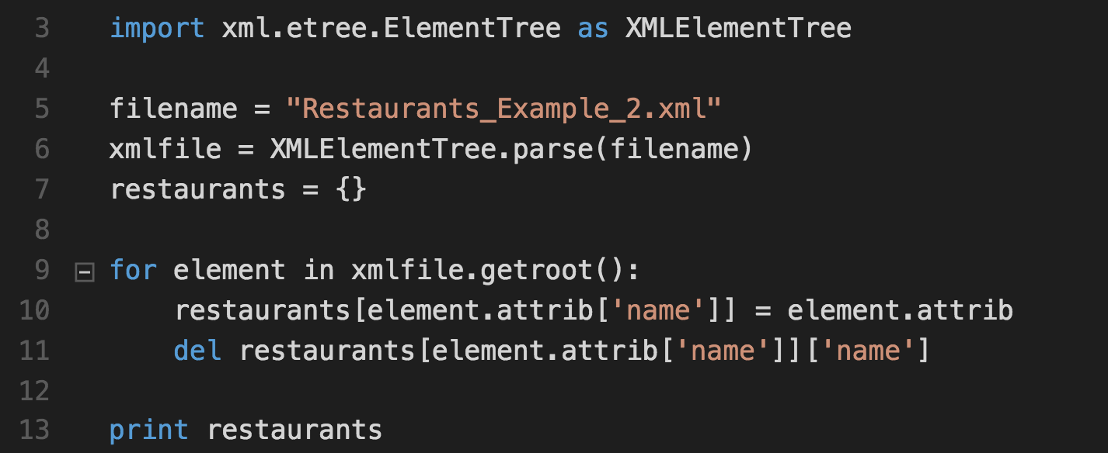
XML - Continued
Different XML Schemas require very different code to understand them
Notes:
Have a go at writing a parser for example 3

Slide 6
SQL
Which implementation?
MS – SQL
MySQL / Maria DB
SQLite
Oracle, etc…

Slide 7
SQL
Which implementation?
MS – SQL
MySQL / Maria DB
SQLite
Oracle, etc…
Python doesn’t have a single DB module, unlike Perl (DBI), Java (JDBC), etc
DB-API is a standard for DB connectivity modules.
Notes:
The great thing about standards is of course that there are so many of them.

Slide 8
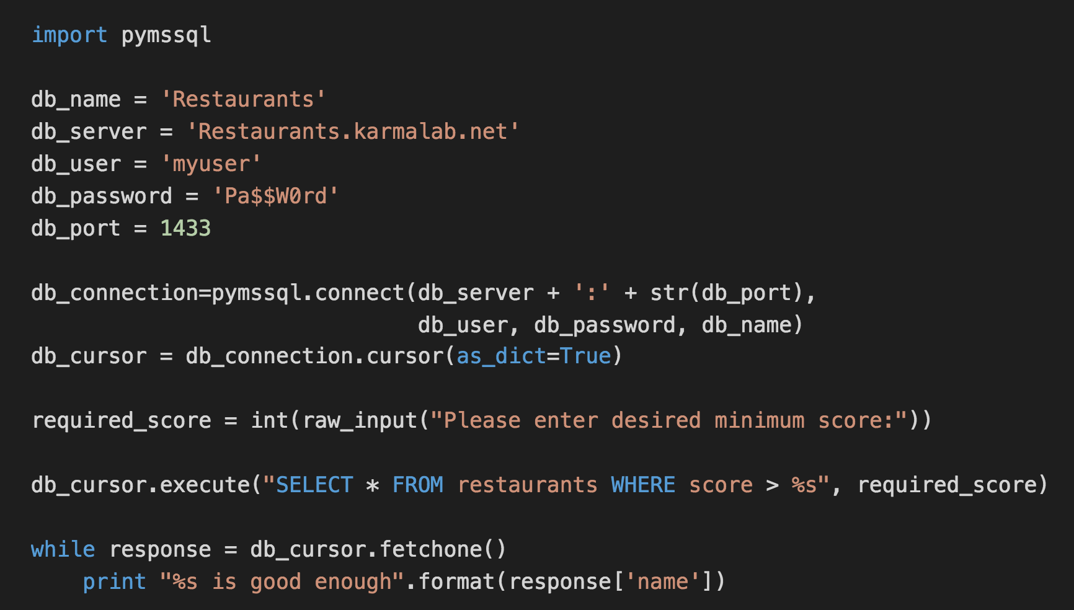
FreeTDS (MS SQL Server) Example

Slide 9
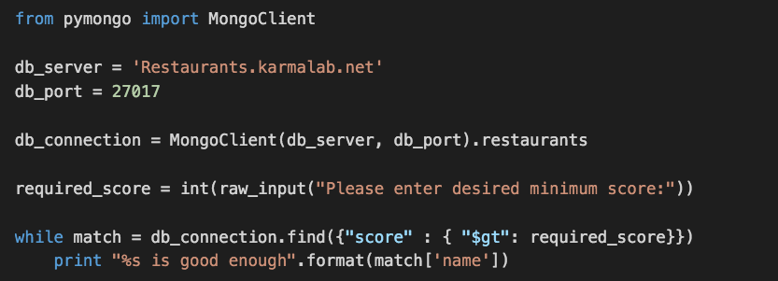
NoSQL (MongoDB)

Slide 10
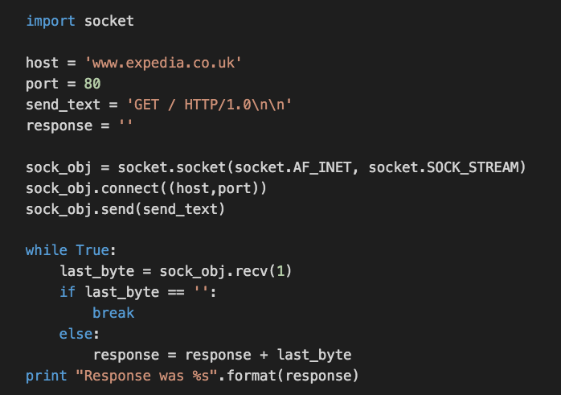
TCP Sockets

Slide 11
Exercise – Complete the REST API
We have a GET request handler. Let’s add:
PUT (adds a new restaurant)
DELETE (deletes an existing restaurant)
Advanced REST Client (Chrome Plugin) might be useful here
Example:
PUT against /restaurants/pret with the following data:
{"fave": "2", "cost": "1", "dist": "2", "type": "sandwich"}

Slide 12
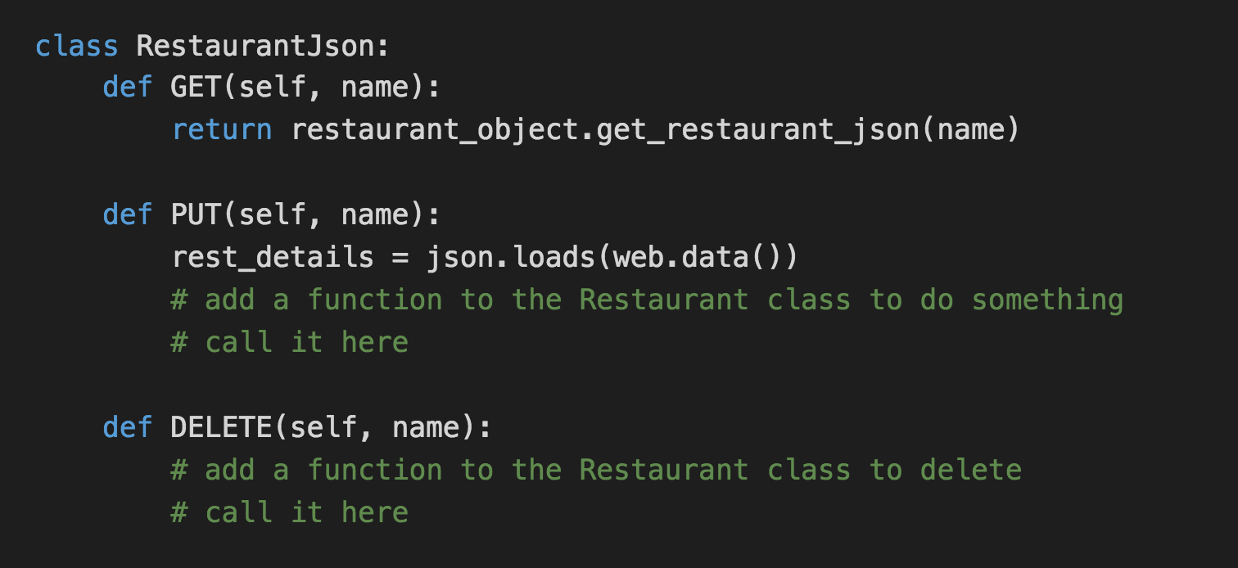
Hints

Slide 13
Extra Credit
Add exception handling for nonexistent restaurants (return a 404)
Should return web.notfound() if it’s not found
Add a POST request handler:
POST against /create with something like the following data:
{"name": "pret", "fave": "2", "cost": "1", "dist": "2", "type": "sandwich"}
Creates /restaurants/pret
Should return a 201 Created status code
Hint: return web.created()

